Slide 1
Geometry & Mensuration

Slide 2
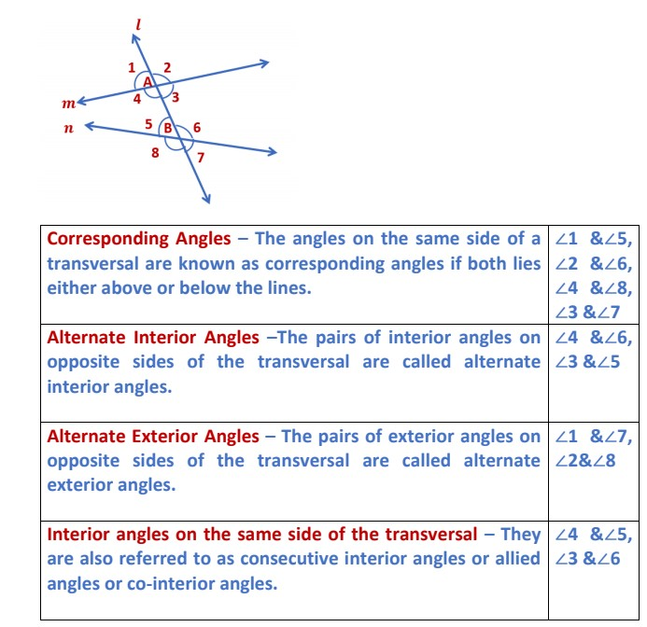
Lines & Angles
Properties Of Parallel Lines
The corresponding angles are equal.
The vertically opposite angles are equal.
The alternate interior angles are equal.
The alternate exterior angles are equal.
The pair of interior angles on the
same side of the transversal
is supplementary.

Slide 3
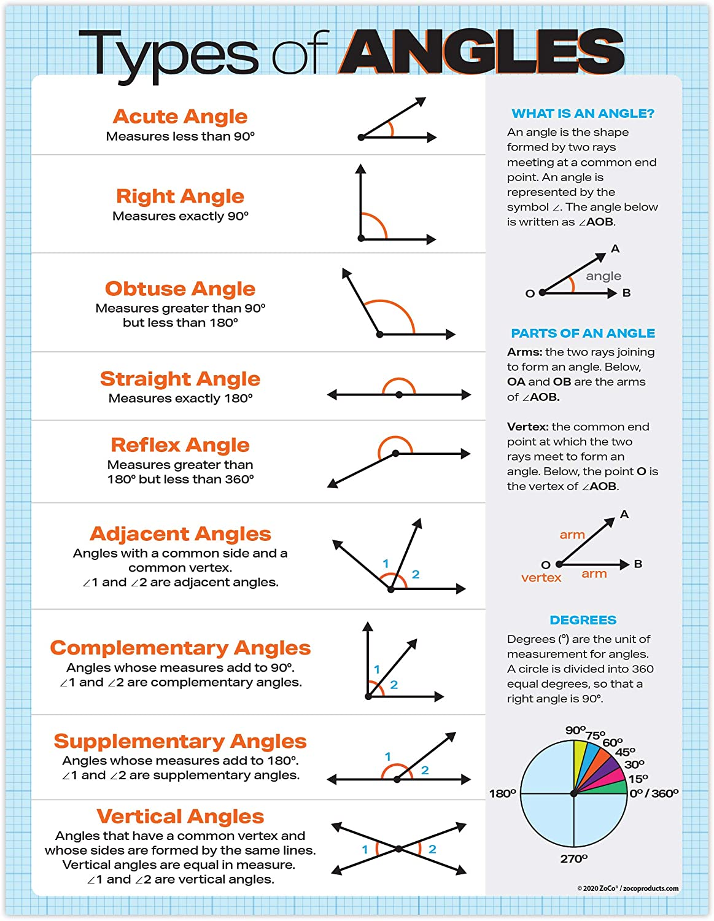
types of angles

Slide 4
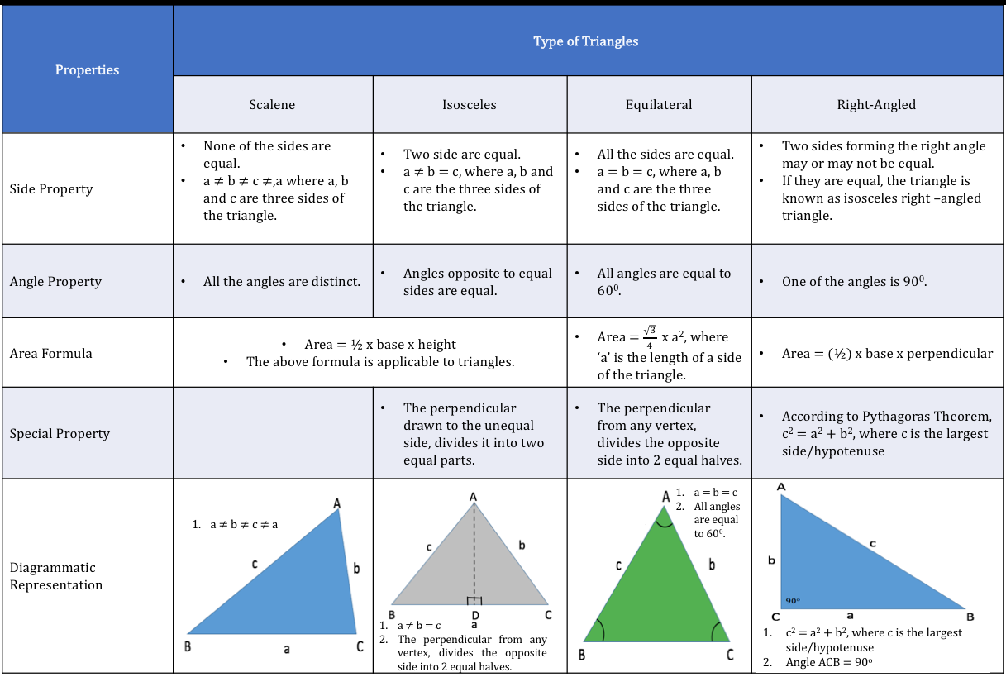
triangles

Slide 5
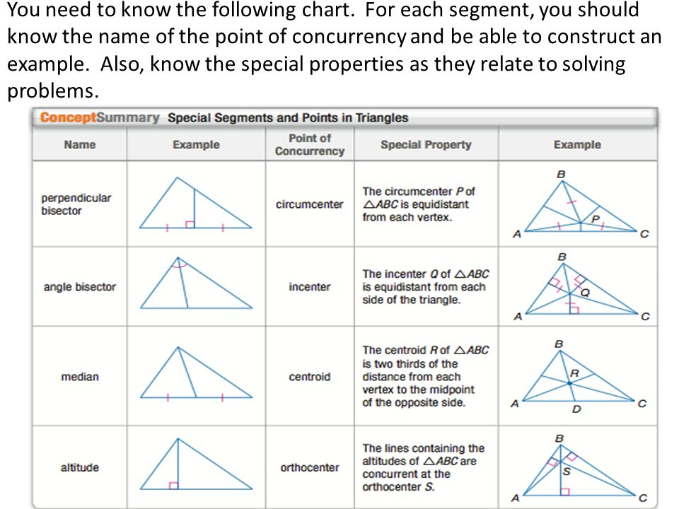
triangles

Slide 6
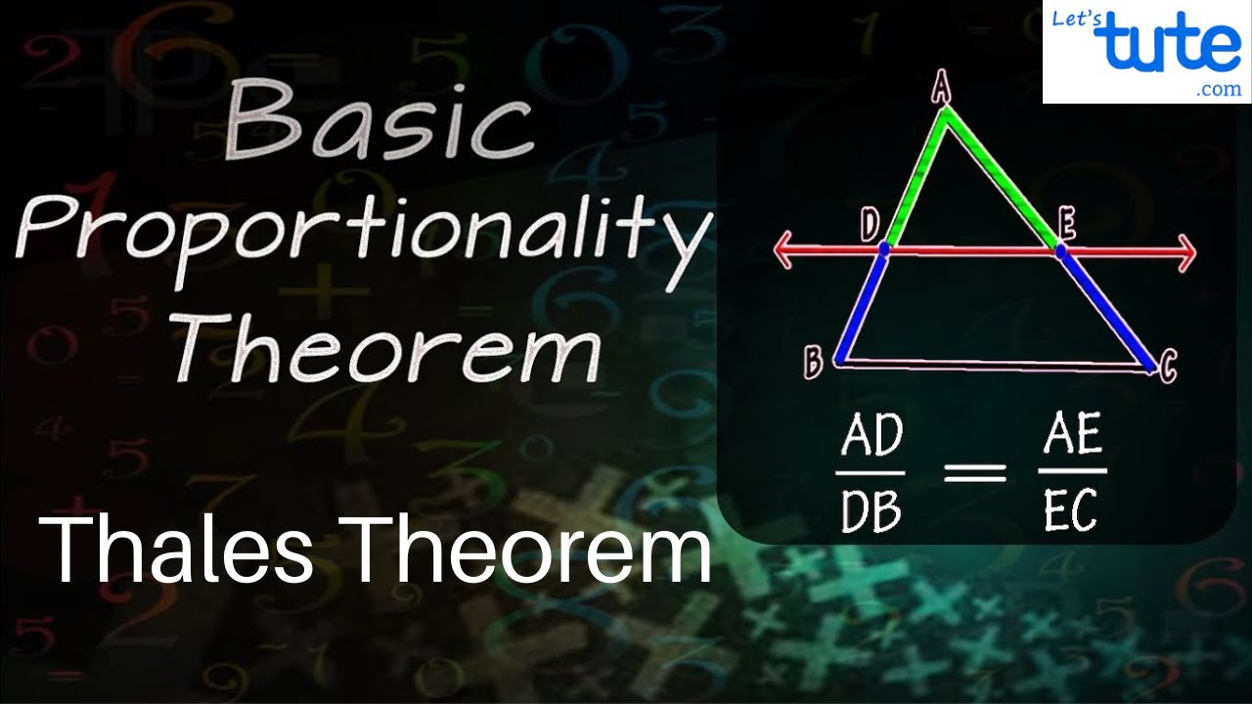
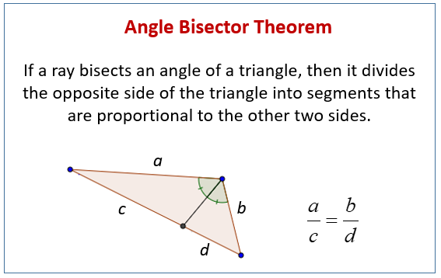
triangles

Slide 7
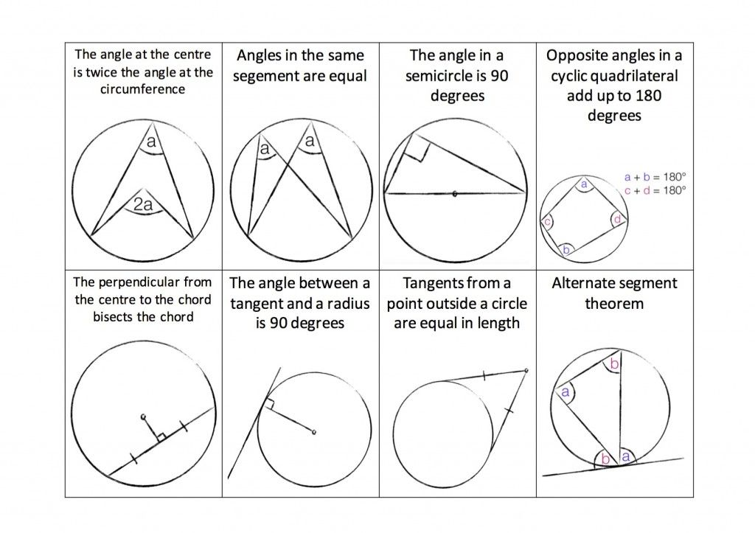
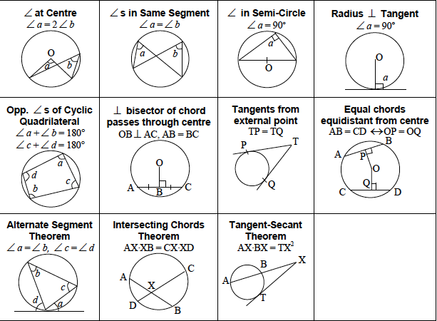
circles

Slide 8
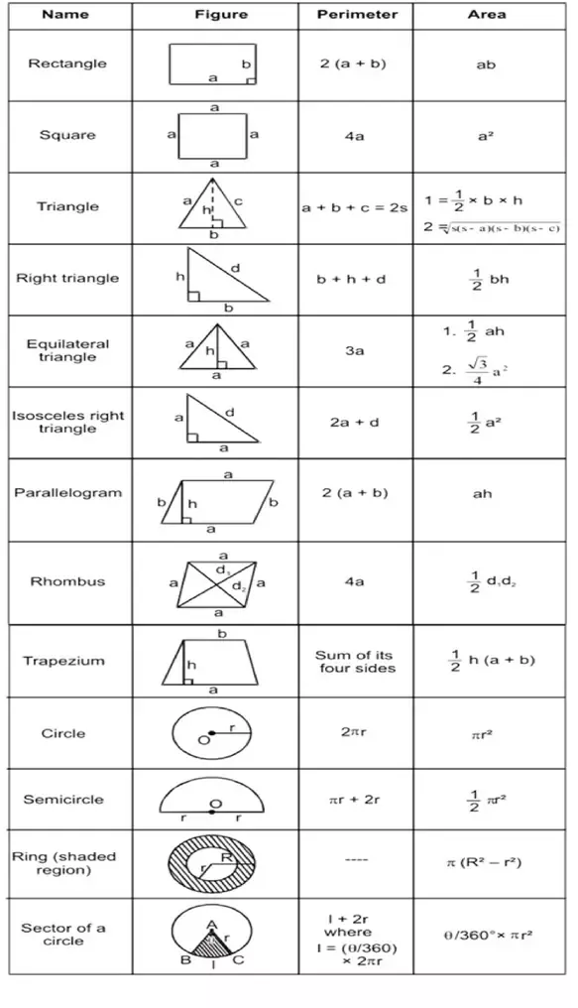
formulae

